Slide 1
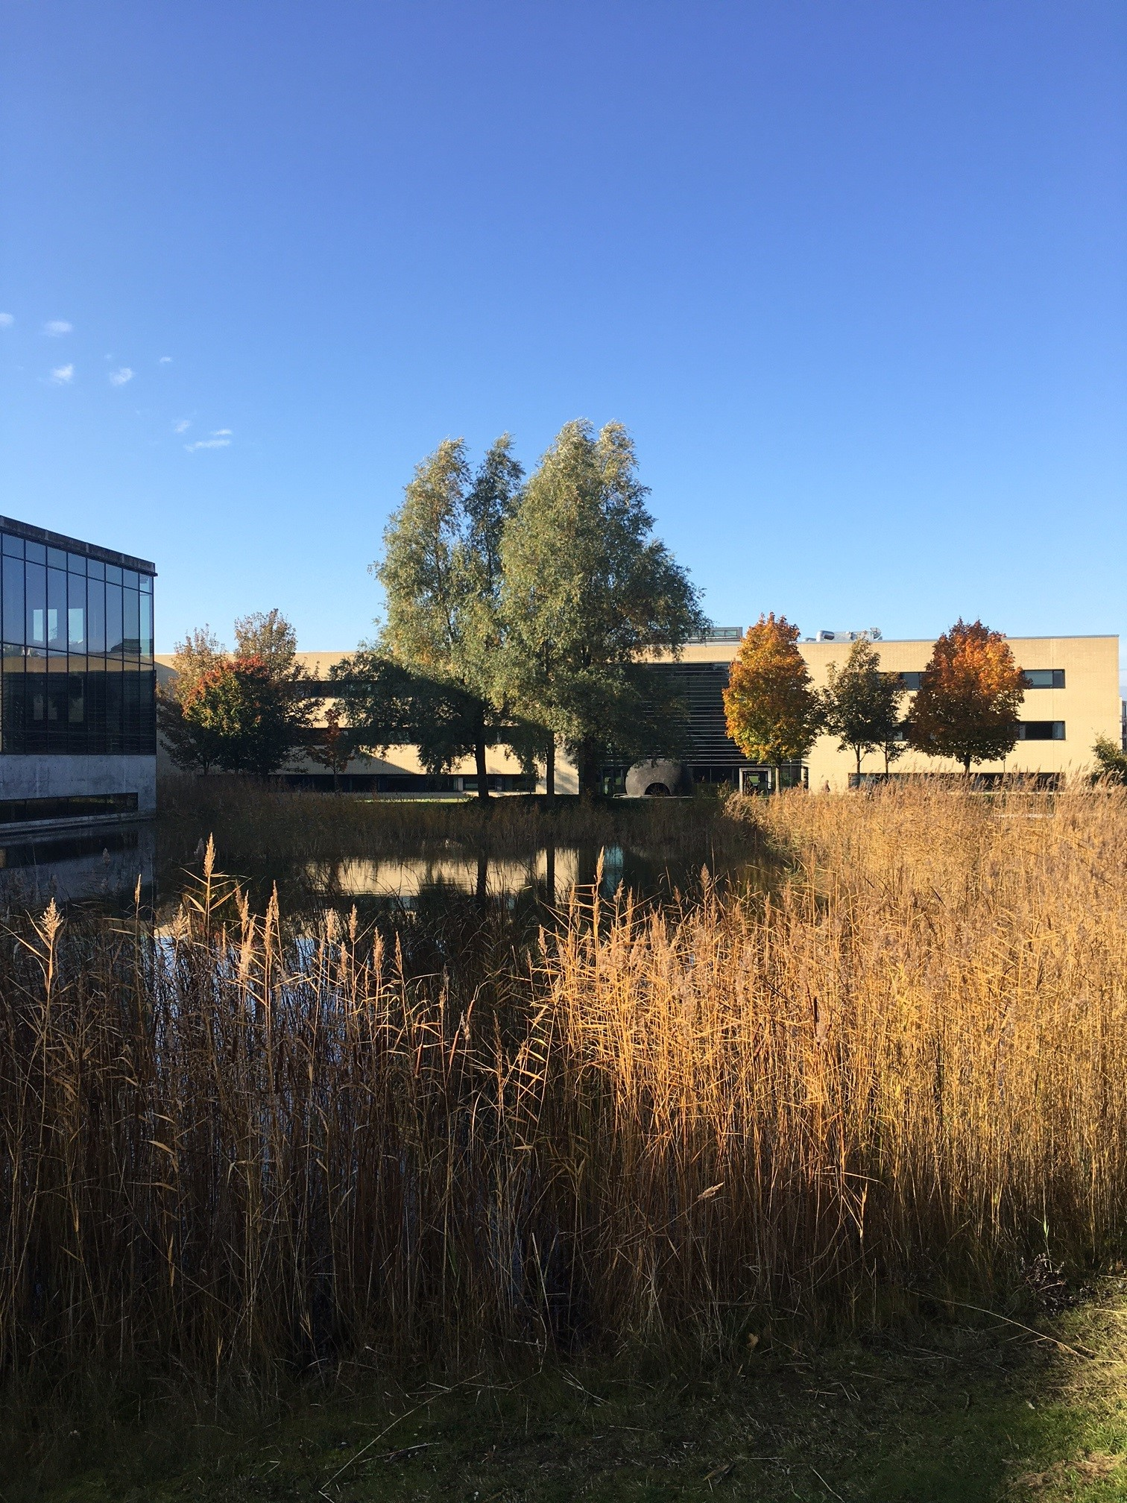
Multiple Correspondence Analysis
Department of Social Sciences and Business Roskilde University

Slide 2
Department of Social Sciences and Business
The data
The data have been collected from the CORDIS database – which is public
The data consists of abstracts of projects which have received funding
SSH research was located using the The European Science Vocabulary (EuroSciVoc)
https://cordis.europa.eu/en
https://op.europa.eu/da/web/eu-vocabularies/euroscivoc
Institut for Samfundsvidenskab og Erhverv Roskilde Universitet

Slide 3
Department of Social Sciences and Business
Topics
Topics are created with Latent Dirichlet Allocation
A topics are created when terms occur frequently together
The abstracts have been cleaned from ‘stop words’ (and, the, a, is, etc.)
We assume that each document can contain multiple topics
The order of words are not considered
We identified 100 topics, but some of these are ‘junk’ topics and therefore discarded
Institut for Samfundsvidenskab og Erhverv Roskilde Universitet

Slide 4
Department of Social Sciences and Business
The Basics of MCA
MCA is a method to simplify and structure large matrixes of data
Unlike principal component analysis, the data in MCA’s is categorical
Points which are close to each other are similar while the ones far apart are dissimilar
The structure is data-driven, the interpretation is made afterwards
The outputs are called maps
Institut for Samfundsvidenskab og Erhverv Roskilde Universitet

Slide 5
The data:
 | Topic 1 | Topic 2 | Topic 3 | Topic n
Abstract 1 | True | False | False
Abstract 2 | False | True | False
Abstract 3 | False | True | True
Abstract n
Department of Social Sciences and Business Roskilde University

Slide 6
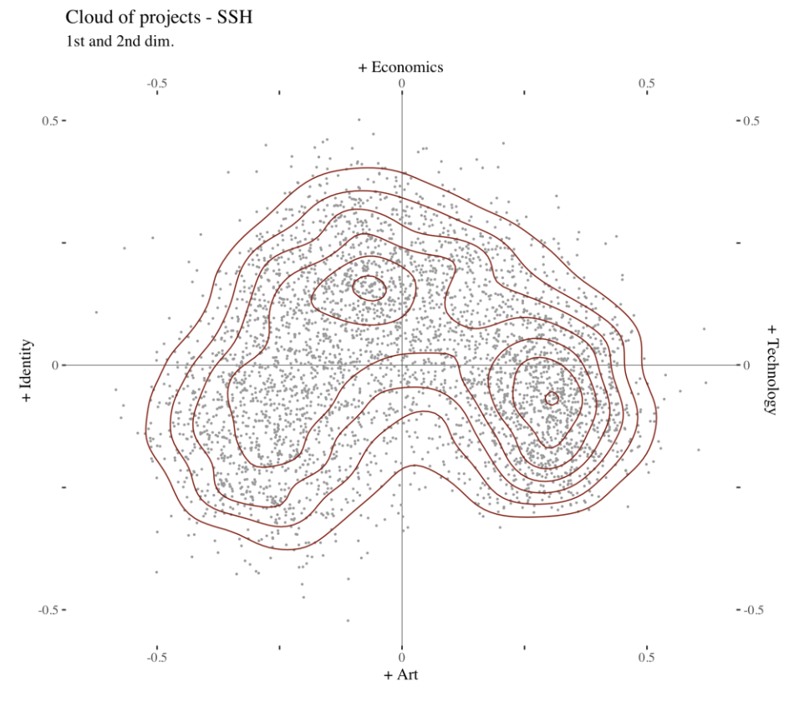
The maps
This is the cloud of individuals (abstracts)
This shows where the data is concentrated
Department of Social Sciences and Business Roskilde University

Slide 7
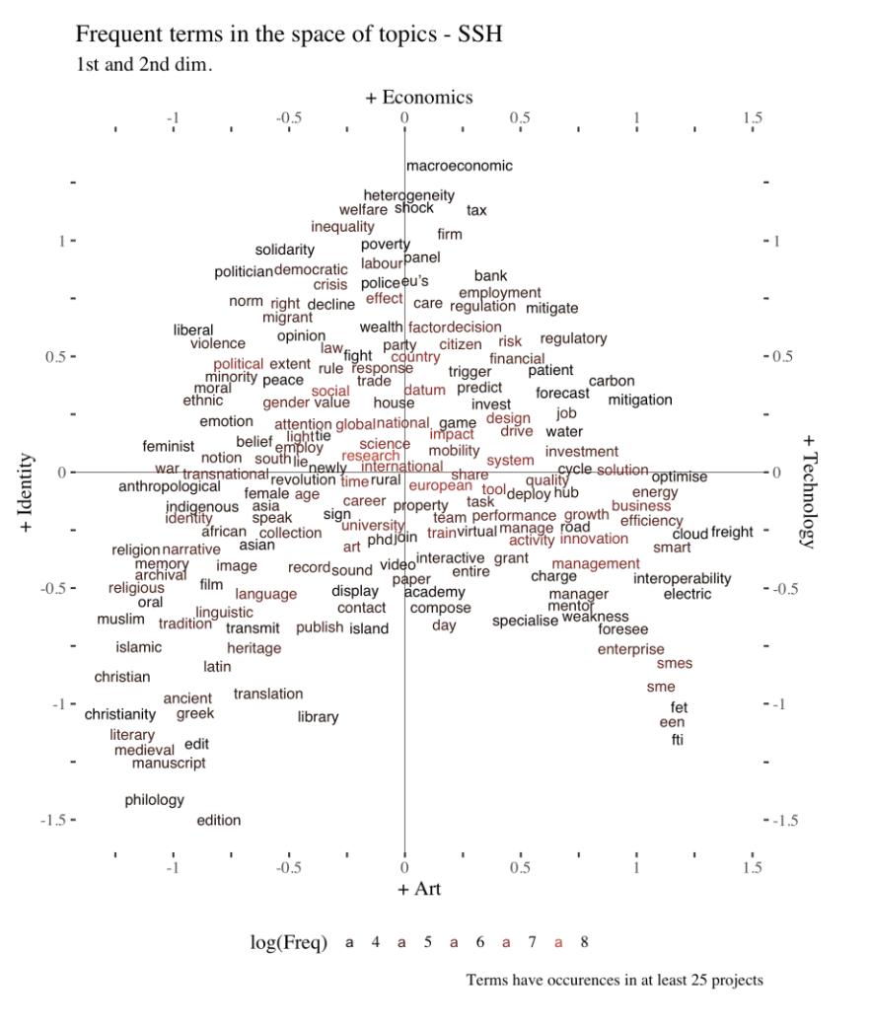
The maps
This is the cloud of terms
Here we see what terms are used in the abstracts and their relations (close/far)
Department of Social Sciences and Business Roskilde University

